Slide 1


Emilia Millan Zaragoza
January 13th, 2024
Project Link

Slide 2

Outline
Executive Summary
Introduction
Methodology
Results
Conclusion
Appendix

Slide 3

Executive Summary
Summary of methodologies
Data Collection through API
Data Collection with Web Scraping
Data Wrangling
Exploratory Data Analysis with SQL
Exploratory Data Analysis with Data Visualization
Interactive Visual Analytics with Folium
Machine Learning Prediction
Summary of all results
Exploratory Data Analysis result
Interactive analytics in screenshots
Predictive Analytics result from Machine Learning Lab

Slide 4

Introduction
SpaceX, an innovative and space-oriented organization is currently offering rocket launches specifically Falcon 9 as low as 62 million dollars. In the space market we often find costs around 165 million dollar per launch. Low prices of SpaceX are due to the idea of reusing the first stage of the launch by re-land the rocket to be used on the next mission. Repeating this process can make the price go down even more.
As a data scientist of SpaceX, the goal of this project is to create the optimal machine learning pipeline to predict the landing outcome of the first stage in the future. This project is crucial in identifying the competitive low price to bid against SpaceX for a rocket launch.
The problems included:
Identifying all critical factors that influence the landing outcome.
The relationship between each variables and how it is affecting the outcome.
The optimal condition required to increase probability of successful landing.

Slide 5

Section 1

Slide 6

Methodology
Executive Summary
Data collection methodology:
Describe how data was collected
Perform data wrangling
Describe how data was processed
Perform exploratory data analysis (EDA) using visualization and SQL
Perform interactive visual analytics using Folium and Plotly Dash
Perform predictive analysis using classification models
How to build, tune, evaluate classification models

Slide 7
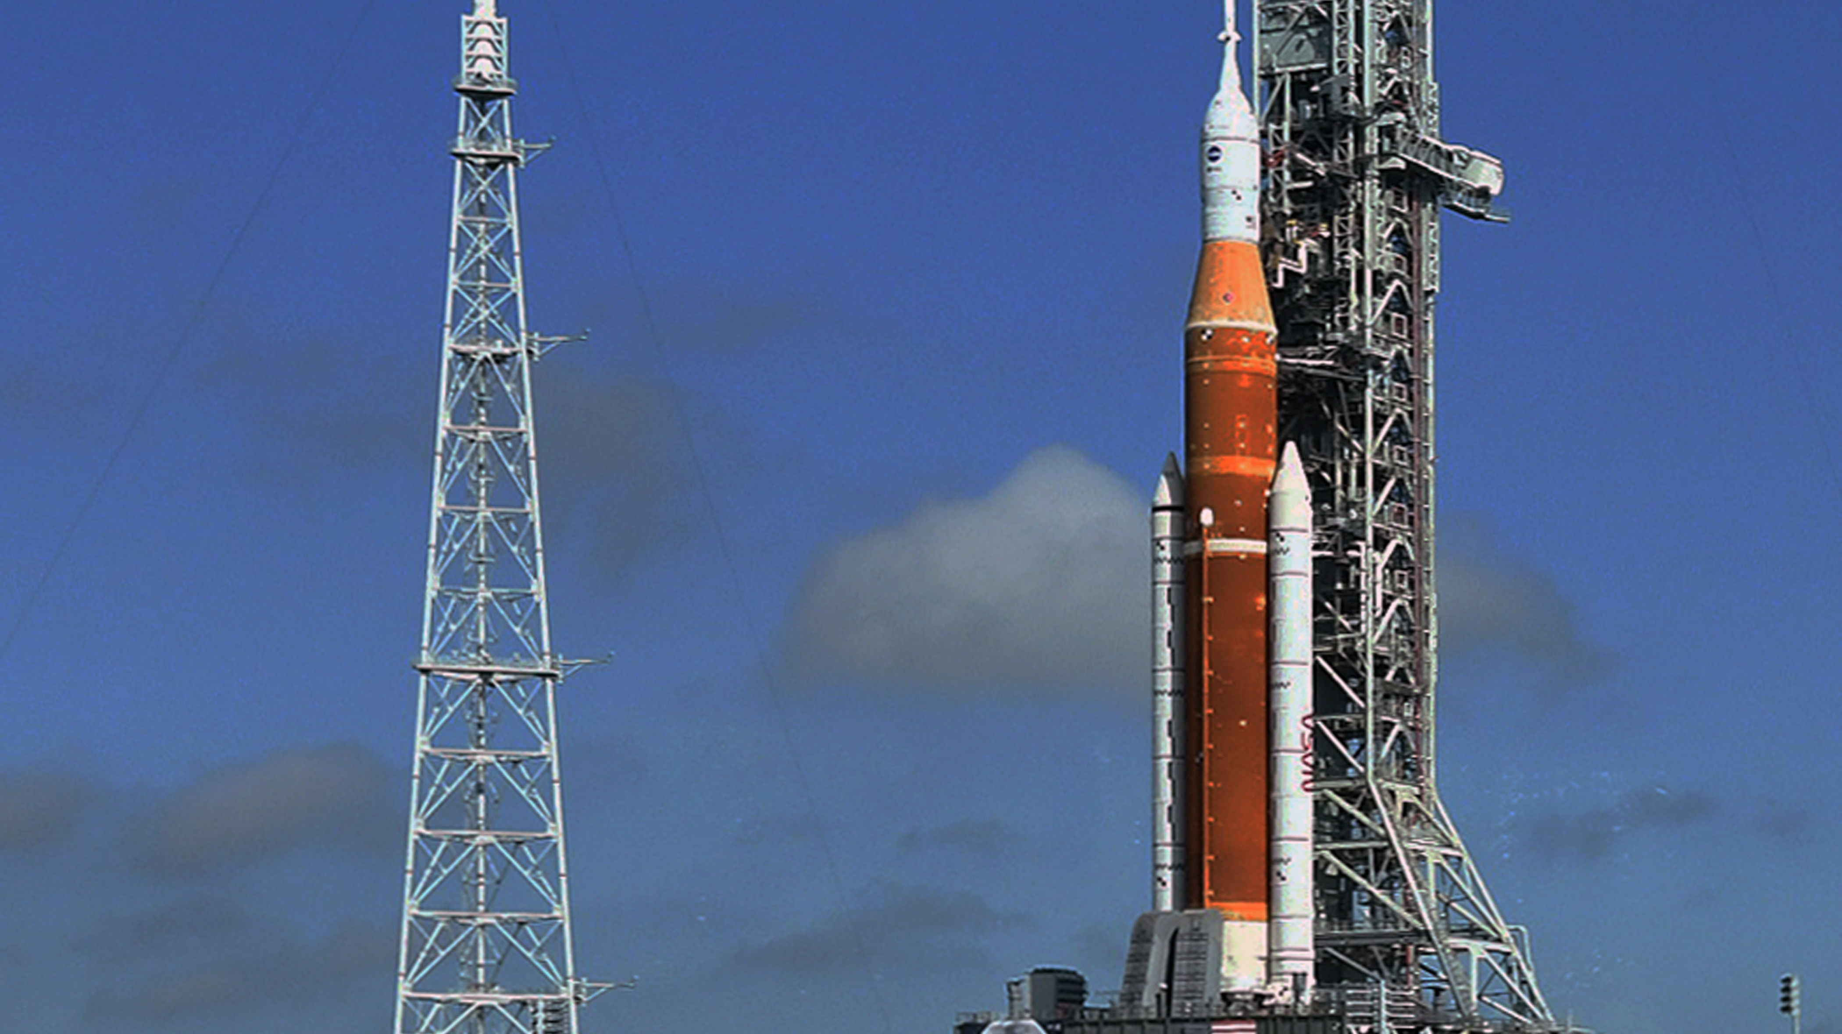
Data Collection
Data collection is the process of gathering and measuring information on targeted variables in an established system. This process enables to answer relevant questions and evaluate outcomes. As mentioned, the dataset was collected by REST API and Web Scrapping from Wikipedia
For REST API, started by using the get request. Then, decoded the response content as JSON and convert into a pandas dataframe using json_normalize().
Next step: cleaned the data, checked for missing values and fill with whatever needed.
For web scrapping, used BeautifulSoup to extract the launch records as HTML table, parse the table and convert it to a pandas dataframe for further data analysis.

Slide 8


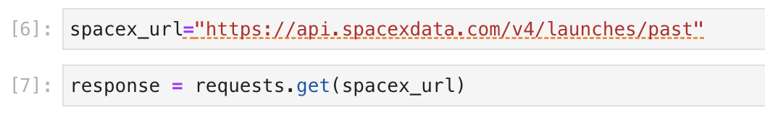
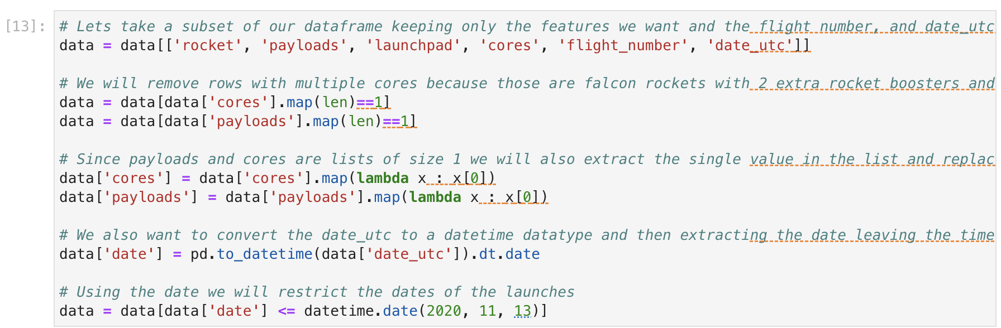
Data Collection – SpaceX API
Get request for rocket launch data using API
Use json_normalize method to convert json result to dataframe
Performed data cleaning and filling the missing value
Notebook Data Collection API

Slide 9

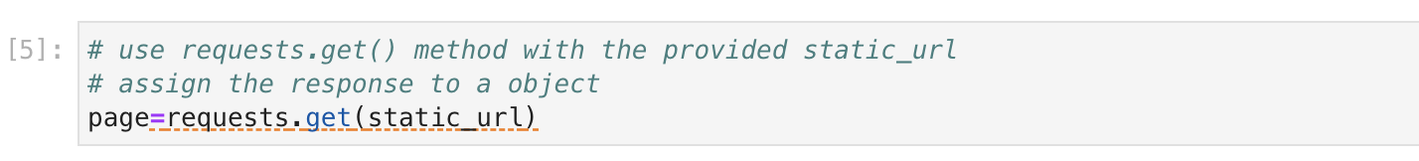
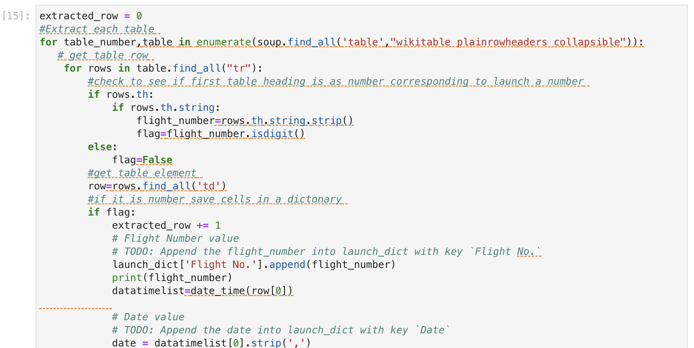
Data Collection - Scraping
Reuest the Falcon9 Launch Wiki page from url
Create a BeautifulSoup from the HTML response
Extract all column/variable names from the HTML header
Notebook Data Collection - Scraping

Slide 10
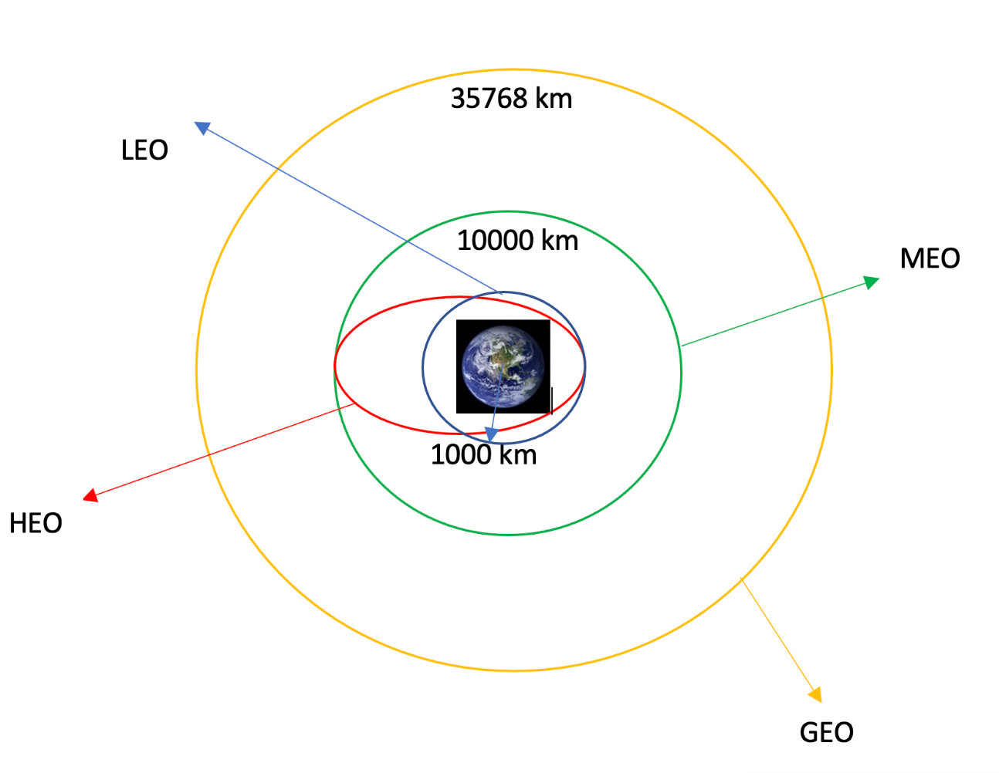
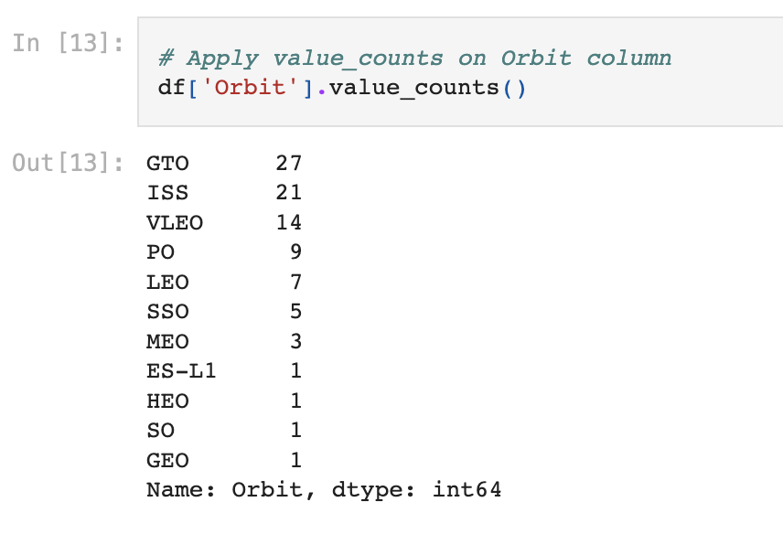
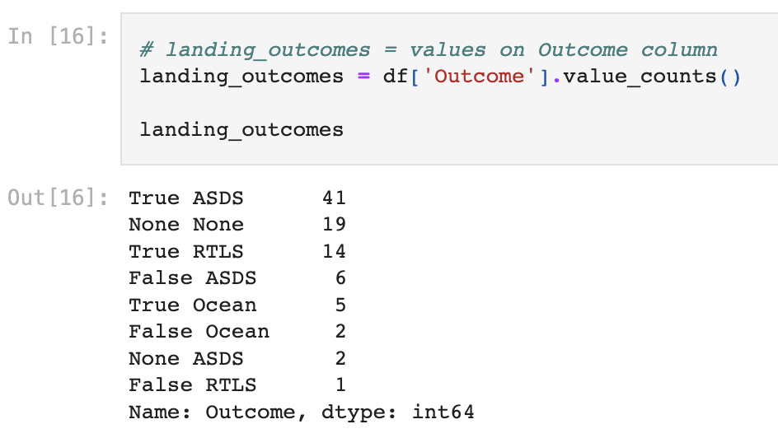
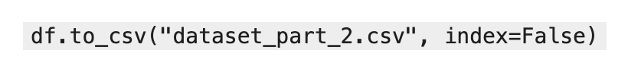
Data Wrangling
Data Wrangling is the process of cleaning and unifying messy and complex data sets for easy access and Exploratory Data Analysis (EDA).
First step is to calculate the number of launches on each site, then calculate the number and occurrence of mission outcome per orbit type.
Then we create a landing outcome label from the outcome column. This will facilitate further analysis, visualization, and ML. Lastly, we will export the result to a CSV.
Notebook Data Wrangling

Slide 11
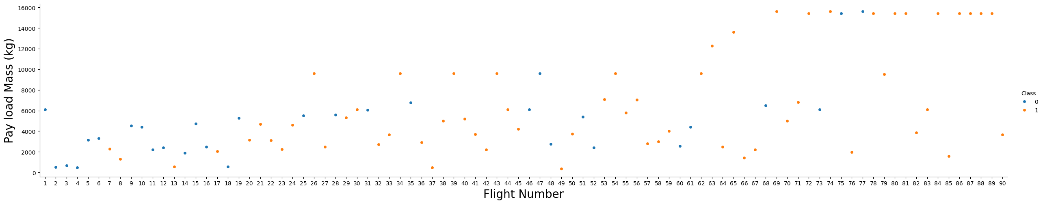
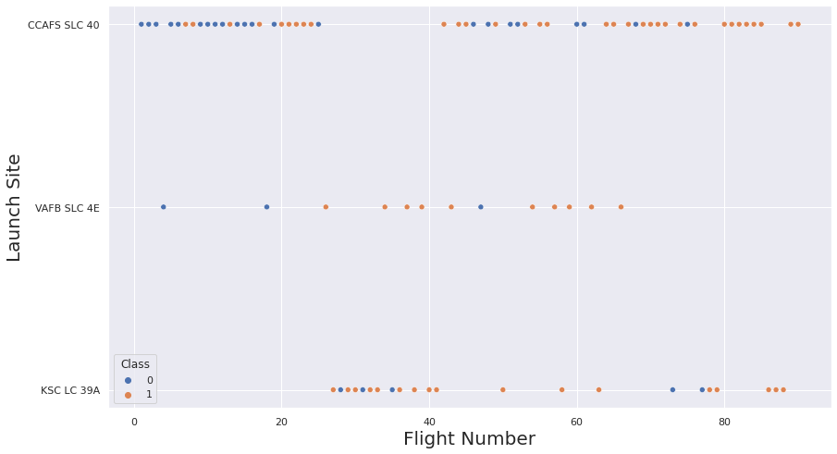
EDA with Data Visualization
We first started by using scatter graph to find the relationship between the attributes such as between:
Pay load and Flight Number.
Flight Number and Launch Site
Notebook Data Visualization

Slide 12
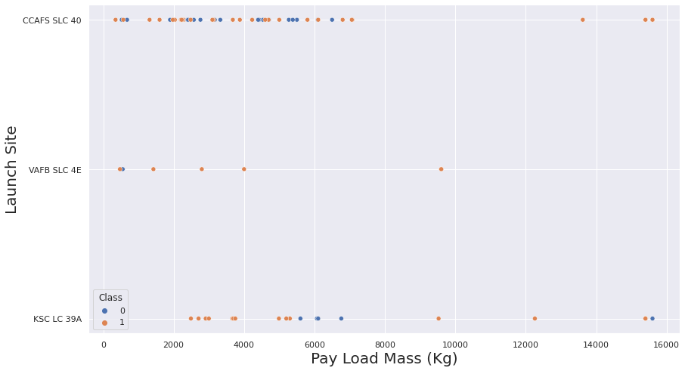
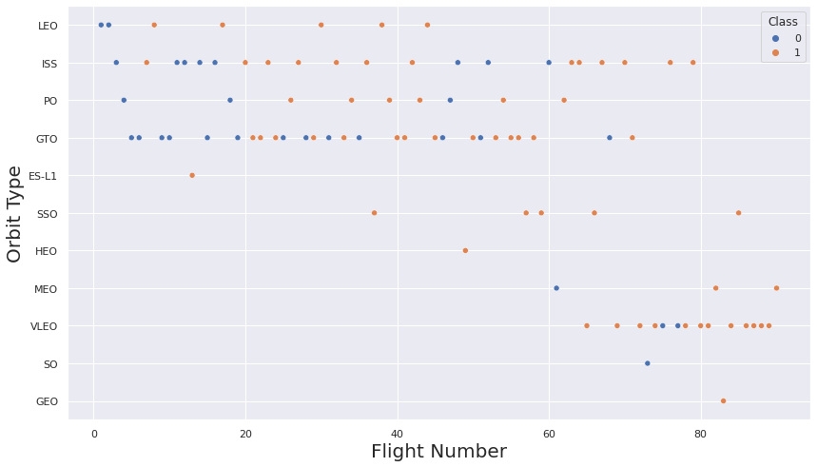
EDA with Data Visualization
We first started by using scatter graph to find the relationship between the attributes such as between:
Pay load and Launch Site
Flight Number and Orbit Type
Notebook Data Visualization

Slide 13
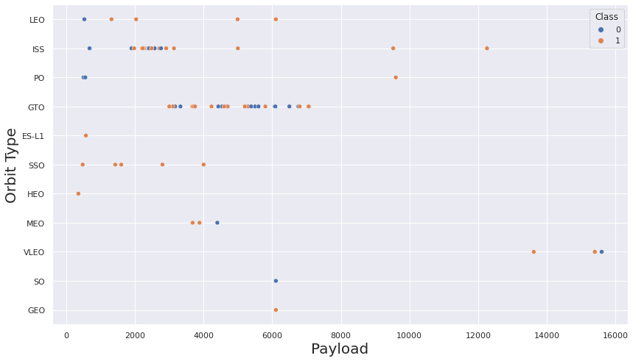
EDA with Data Visualization
We first started by using scatter graph to find the relationship between the attributes such as between:
Payload and Orbit Type.
Scatter plots show dependency of attributes on each other.
Once a pattern is determined from the graphs. It’s very easy to see which factors affecting the most to the success of the landing outcomes.
Notebook Data Visualization

Slide 14
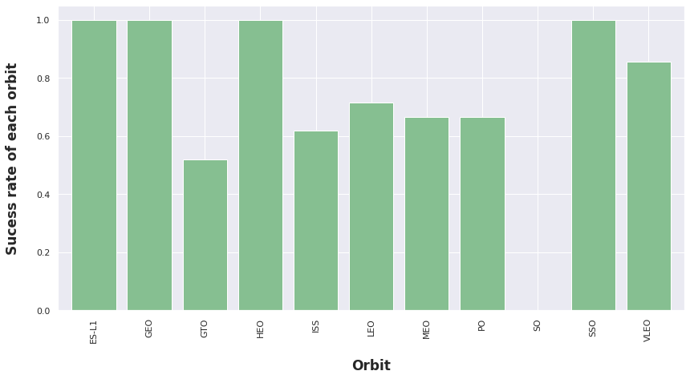
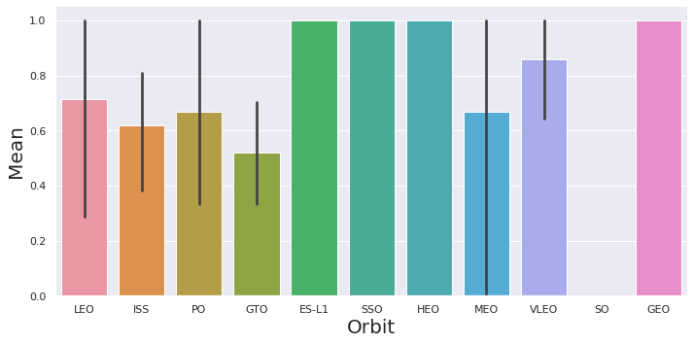
EDA with Data Visualization
For further visualization analysis we used tools such as bar graph and line plots graph
Bar graphs is one of the easiest way to interpret the relationship between the attributes. In this case, we will use the bar graph to determine which orbits have the highest probability of success.
We then use the line graph to show a trends or pattern of the attribute over time which in this case, is used for see the launch success yearly trend.
Notebook Data Visualization

Slide 15
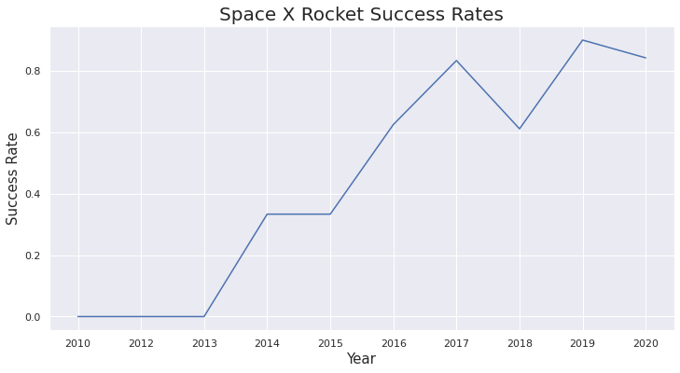
EDA with Data Visualization
We then use Feature Engineering to be used in success prediction in the future module by created the dummy variables to categorical columns.
Notebook Data Visualization

Slide 16
EDA with SQL
Using SQL, we had performed many queries to get better understanding of the dataset, Ex:
Displaying the names of the launch sites.
Listing the names of the boosters which have success in drone ship and have payload mass greater than 4000 but less than 6000.
Displaying 5 records where launch sites begin with the string ‘CCA’.
Listing the total number of successful and failure mission outcomes.
Displaying the total payload mass carried by booster launched by NASA (CRS).
Listing the names of the booster_versions which have carried the maximum payload mass
Displaying the average payload mass carried by booster version F9 v1.1.
Listing the failed landing_outcomes in drone ship, their booster versions, and launch sites names for in year 2015.
Listing the date when the first successful landing outcome in ground pad was achieved.
Rank the count of landing outcomes or success between the date 2010-06-04 and 2017-03-20, in descending order.
Notebook EDA with SQL

Slide 17
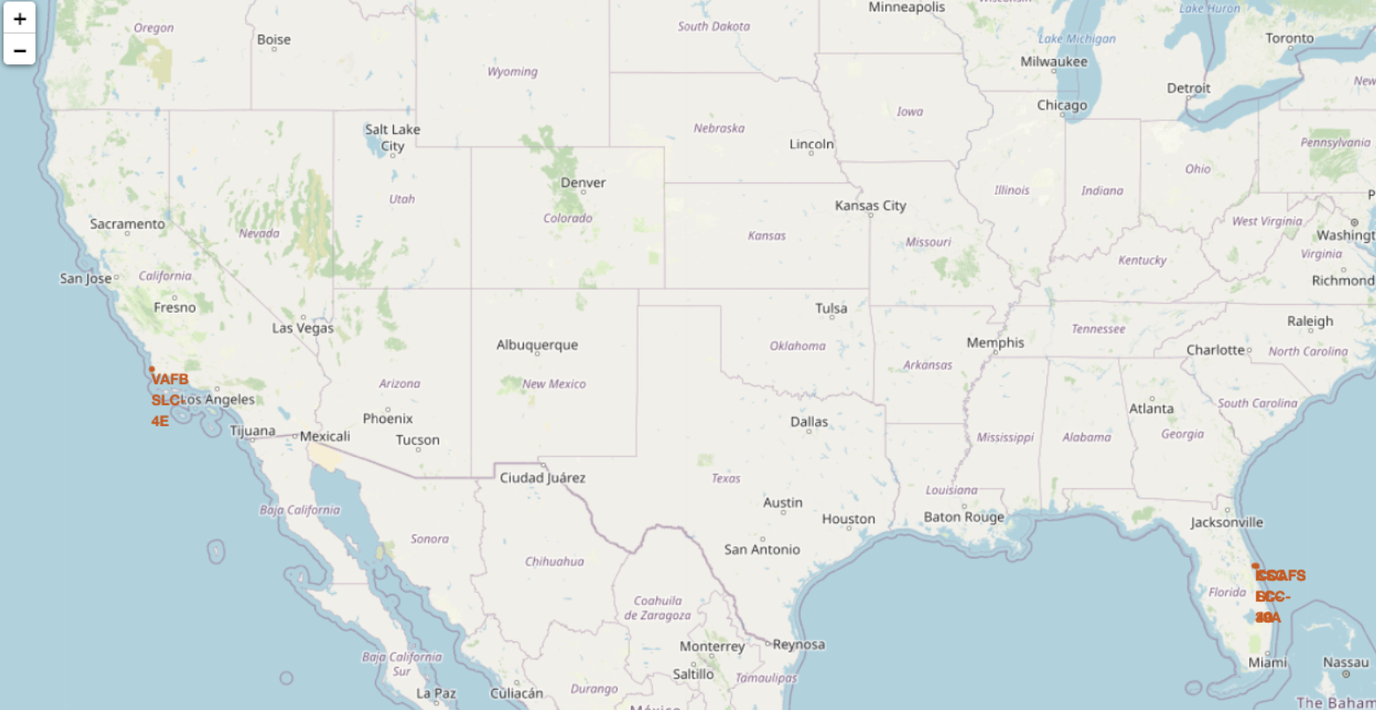
Build an Interactive Map with Folium
To visualize the launch data into an interactive map. We took the latitude and longitude coordinates at each launch site and added a circle marker around each launch site with a label of the name of the launch site.
We then assigned the dataframe launch_outcomes(failure,success) to classes 0 and 1 with Red and Green markers on the map in MarkerCluster().
We then used the Haversine’s formula to calculated the distance of the launch sites to various landmark to find answer to the questions of:
How close the launch sites with railways, highways and coastlines?
How close the launch sites with nearby cities?
Notebook Map with Folium

Slide 18
Build a Dashboard with Plotly Dash
We built an interactive dashboard with Plotly dash which allowing the user to play around with the data as they need.
We plotted pie charts showing the total launches by a certain sites.
We then plotted scatter graph showing the relationship with Outcome and Payload
Mass (Kg) for the different booster version.
Notebook Plotly Dash

Slide 19
Predictive Analysis (Classification)
Building the Model
Load the dataset into NumPy and Pandas
Transform the data and then split into training and test datasets
Decide which type of ML to use
Set the parameters and algorithms to GridSearchCV and fit it to dataset.
Evaluating the Model
Check the accuracy for each model
Get tuned hyperparameters for each type of algorithms.
Plot the confusion matrix.
Improving the Model
Use Feature Engineering and Algorithm Tuning
Find the Best Model
The model with the best accuracy score will be the best performing mod
Notebook Plotly Dash

Slide 20
Results
Exploratory data analysis results
Interactive analytics demo in screenshots
Predictive analysis results

Slide 21

Section 2

Slide 22
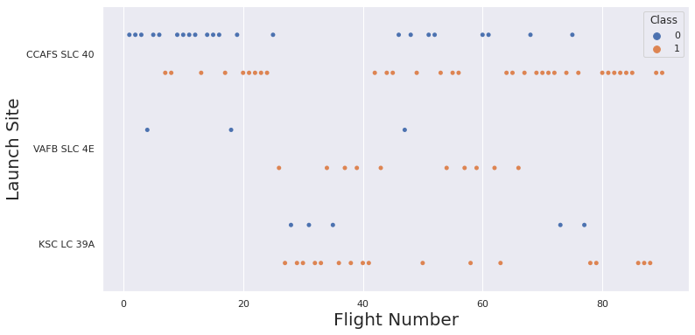
Flight Number vs. Launch Site
This scatter plot interpretation is that the larger the flights amount of the launch site, the greater the the success rate will be.
However, site CCAFS SLC40 shows the least pattern of this rate

Slide 23
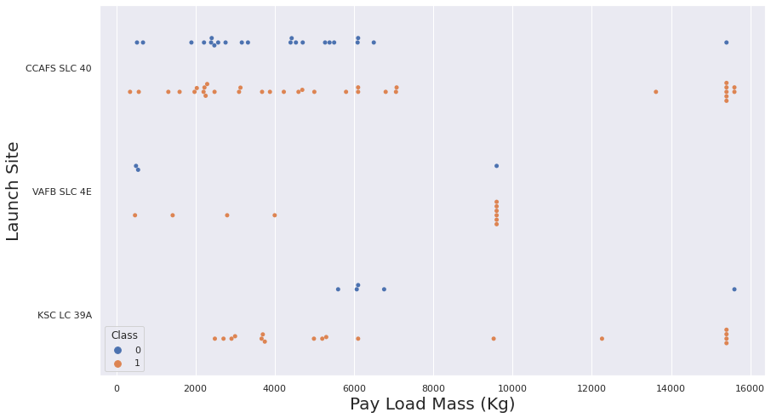
Payload vs. Launch Site
This scatter plot interpretation is that once the pay load mass goes greater than 7000kg, the probability of the success rate will be highly increased.
However, there is no clear pattern to say the launch site is dependent to the pay load mass for the success rate

Slide 24
Success Rate vs. Orbit Type
This bar graph compares the possibility of the orbits to influence the landing outcomes as some orbits has 100% success rate. Such as SSO, HEO, GEO AND ES-L1 while SO orbit produced 0% rate of success.
However, further analysis show that some of this orbits have only 1 occurrence (GEO, SO, HEO and ES-L1) which means this data needs more dataset to see patterns or trends before we draw any conclusion.

Slide 25
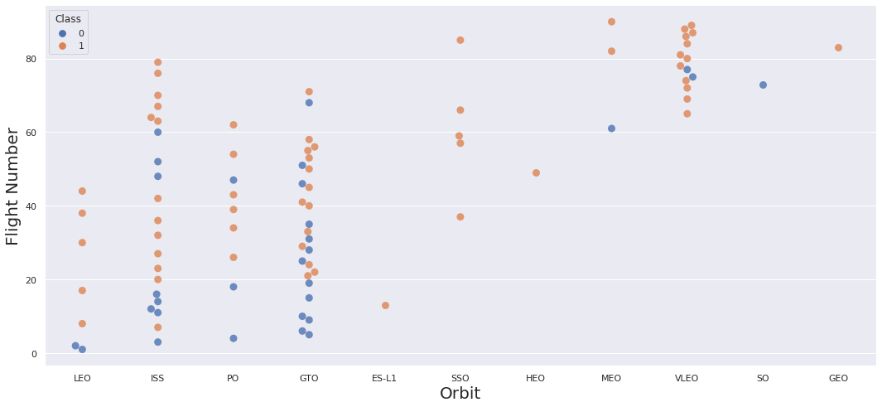
Flight Number vs. Orbit Type
This scatter plot interpretation is the larger the flight number on each orbits, the greater the success rate (especially LEO orbit) except for GTO orbit which depicts no relationship between both attributes.
Orbit with only 1 occurrence should also be excluded from above statement as it’s needed more dataset.

Slide 26
Payload vs. Orbit Type
Heavier payload has positive impact on LEO, ISS and P0 orbit. However, it has negative impact on MEO and VLEO orbit.
GTO orbit seem to depict no relation between the attributes.
Meanwhile, again, SO, GEO and HEO orbit need more dataset to see any pattern or trend.

Slide 27
Launch Success Yearly Trend
This line chart clearly describes the increasing trend from the year 2013 until 2020.
If this trend continues for the next year onward. The success rate will steadily increase until reaching 100% success rate.

Slide 28
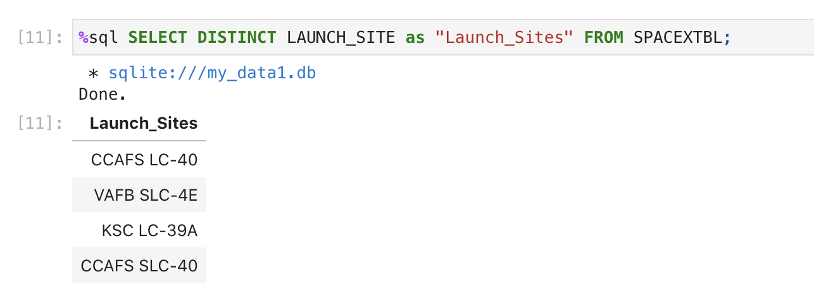
All Launch Site Names
We used the key word DISTINCT to show only unique launch sites from the SpaceX data.

Slide 29
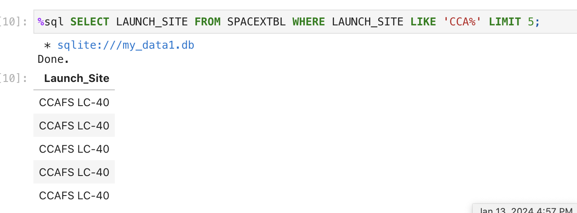
Launch Site Names Begin with 'CCA'
We used the query above to display 5 records where launch sites begin with `CCA`

Slide 30
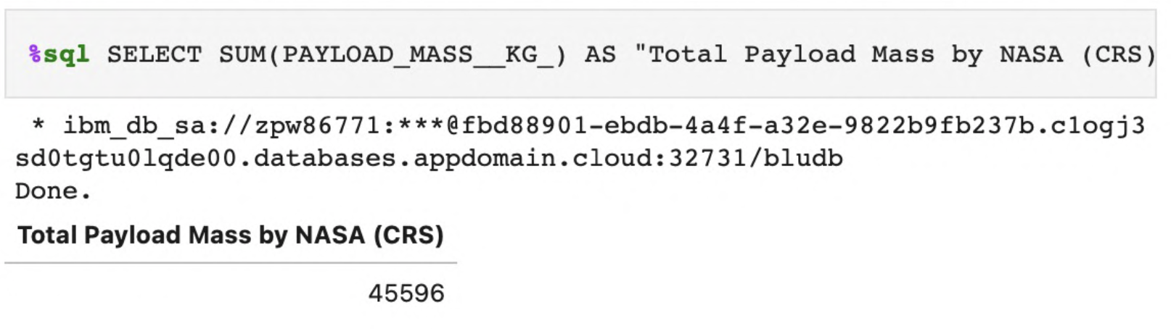
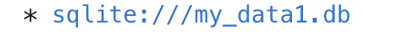

Total Payload Mass
We calculated the total payload carried by boosters from NASA as 45596 using the query below

Slide 31
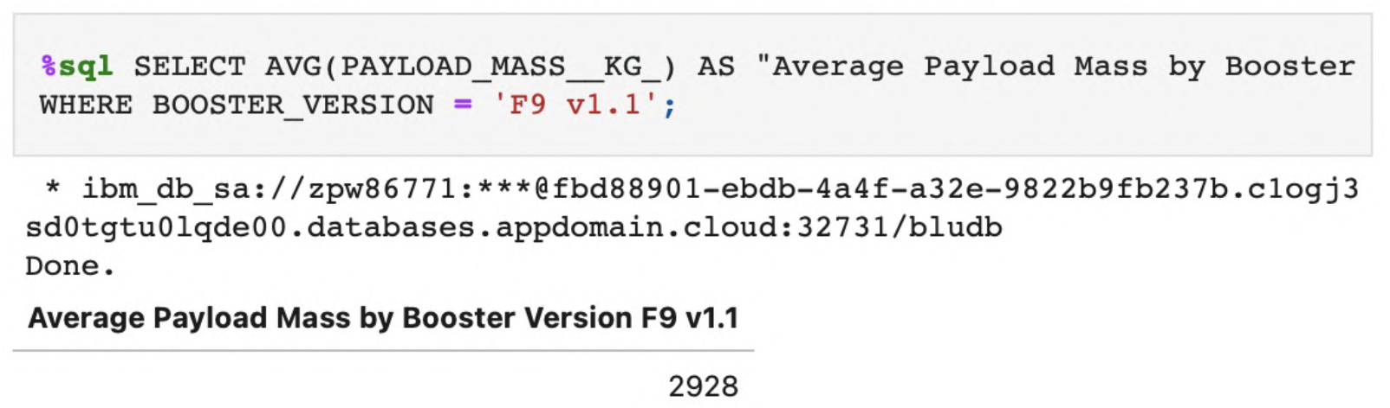
Average Payload Mass by F9 v1.1
We calculated the average payload mass carried by booster version F9 v1.1 as 2928.4

Slide 32
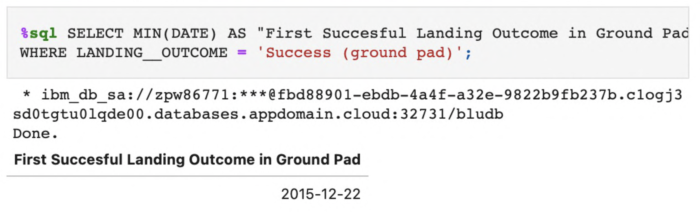
First Successful Ground Landing Date
We use the min() function to find the result
We observed that the dates of the first successful landing outcome on ground pad was 22nd December 2015

Slide 33
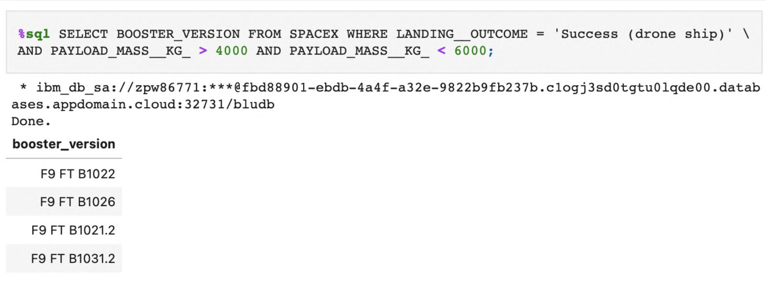
Successful Drone Ship Landing with Payload between 4000 and 6000
We used the WHERE clause to filter for boosters which have successfully landed on drone ship and applied the AND condition to determine successful landing with payload mass greater than 4000 but less than 6000

Slide 34
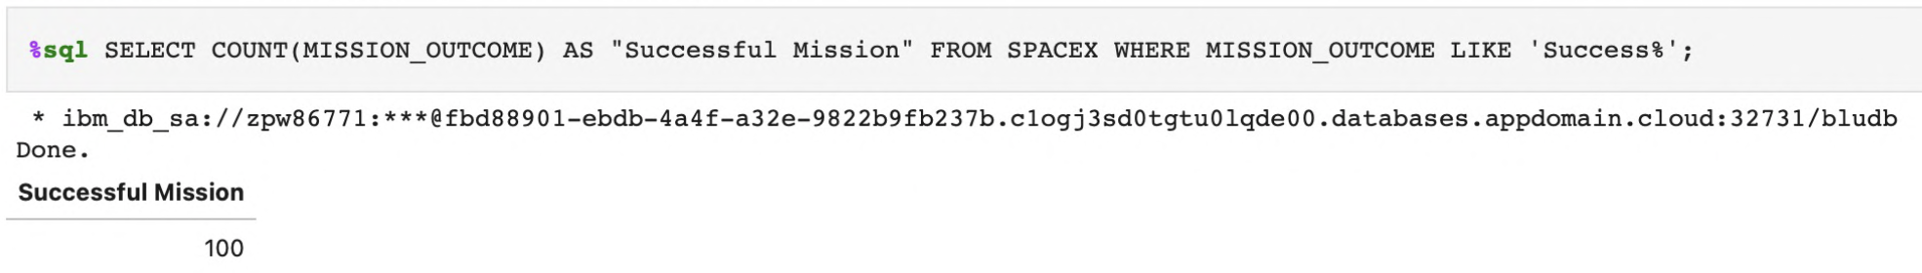
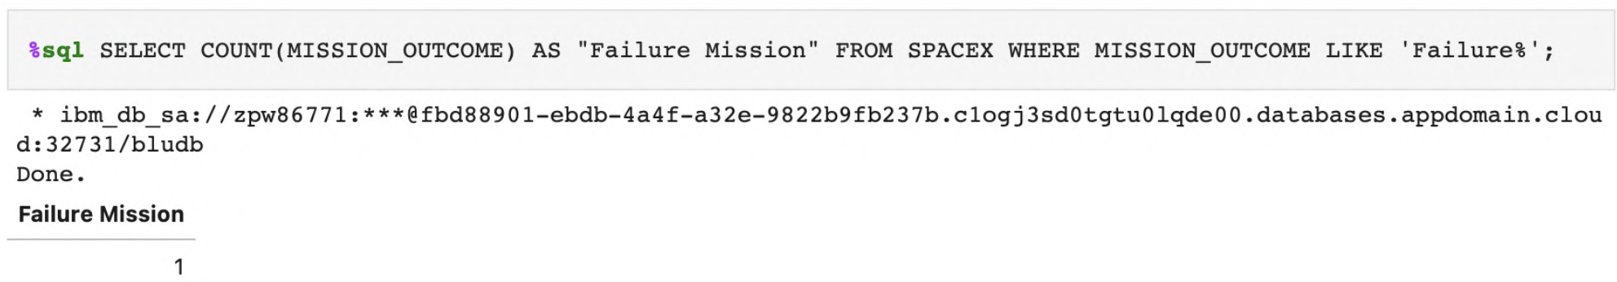
Total Number of Successful and Failure Mission Outcomes
We used wildcard like ‘%’ to filter for WHERE MissionOutcome was a success or a failure.

Slide 35
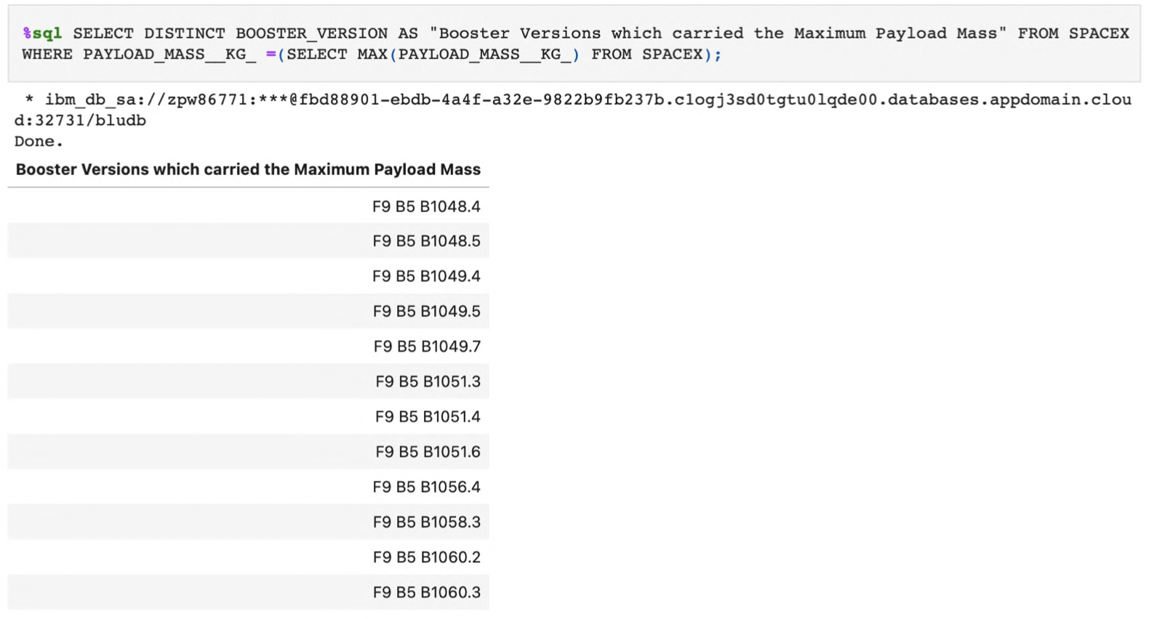
Boosters Carried Maximum Payload
We determined the booster that have carried the maximum payload using a subquery in the WHERE clause and the MAX() function.

Slide 36
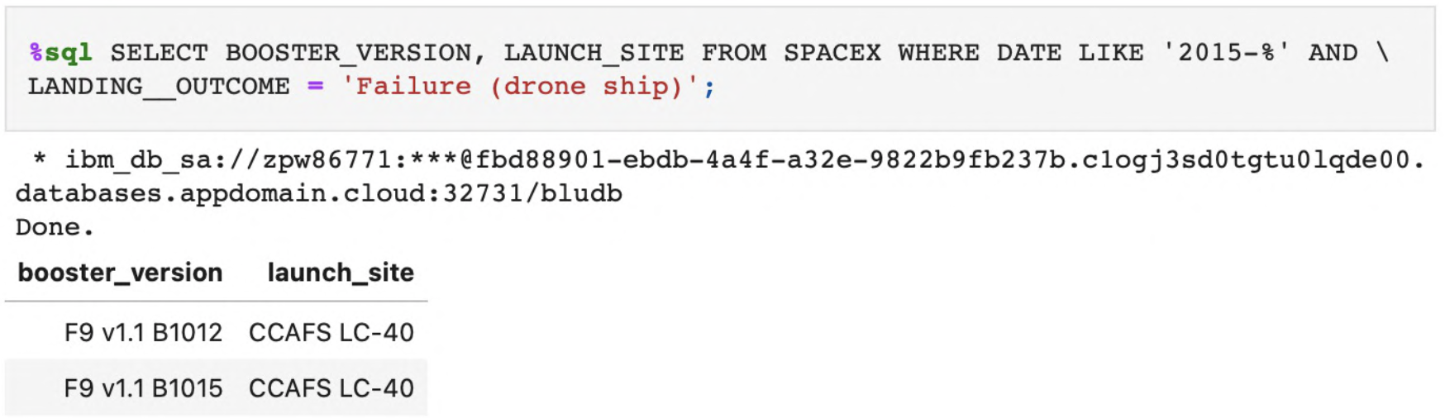
2015 Launch Records
We used a combinations of the WHERE clause, LIKE, AND, and BETWEEN conditions to filter for failed landing outcomes in drone ship, their booster versions, and launch site names for year 2015

Slide 37
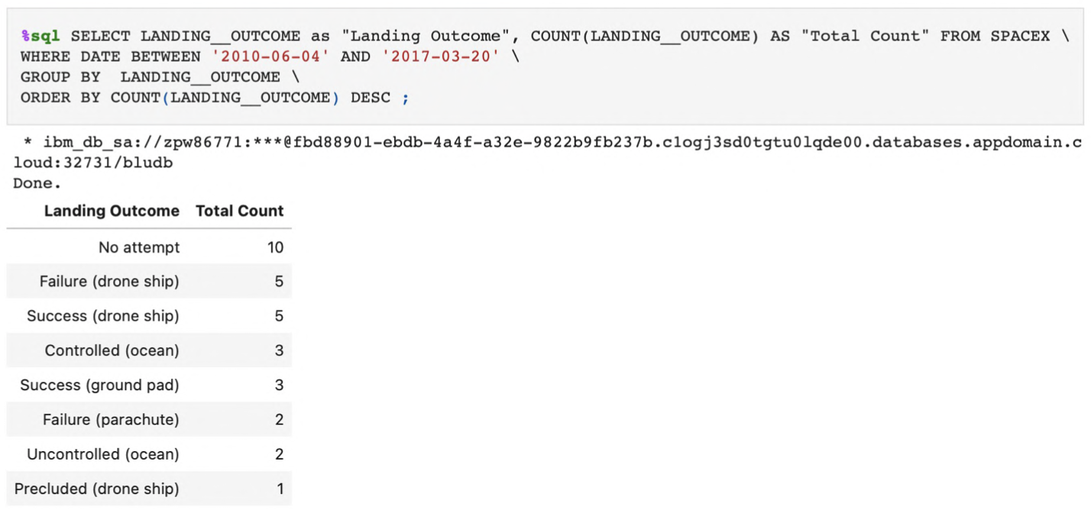
Rank Landing Outcomes Between 2010-06-04 and 2017-03-20
We selected Landing outcomes and the COUNT of landing outcomes from the data and used the WHERE clause to filter for landing outcomes BETWEEN 2010-06-04 to 2010-03-20.
We applied the GROUP BY clause to group the landing outcomes and the ORDER BY clause to order the grouped landing outcome in descending order.

Slide 38

Section 3

Slide 39
Location of all the Launch Sites
We used wildcard like ‘%’ to filter for WHERE MissionOutcome was a success or a failure.
Red point indicate missions with success or failure21qw

Slide 40
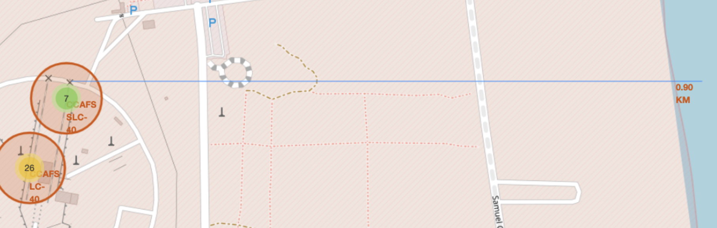
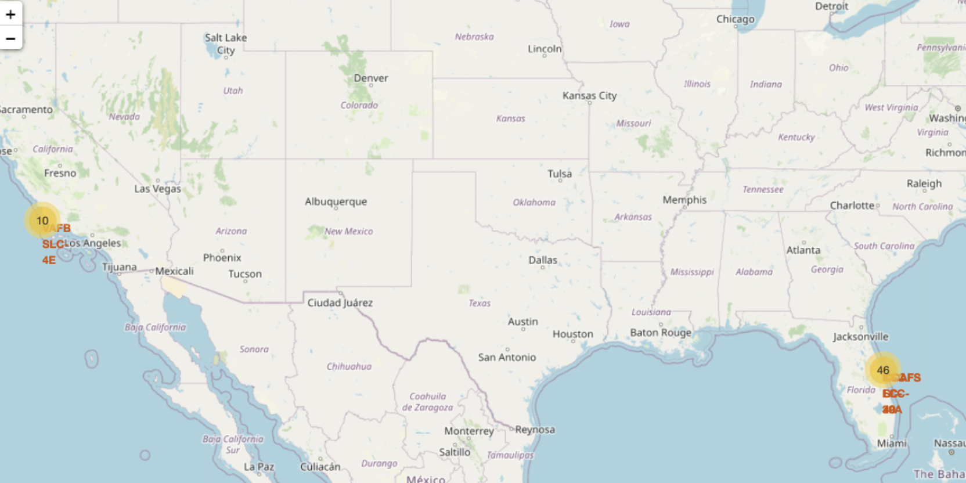
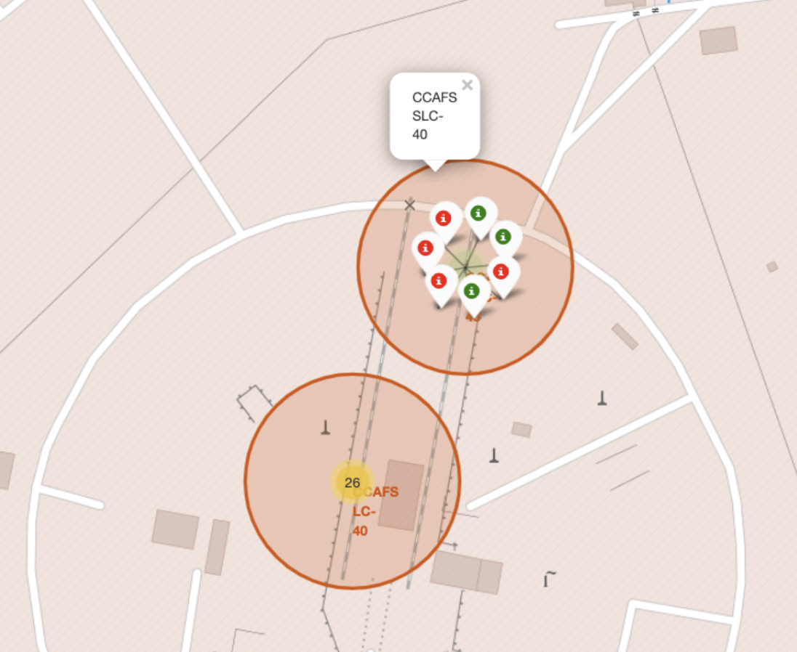
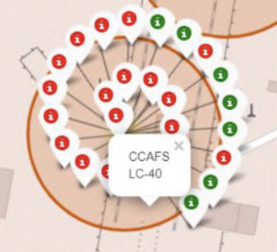
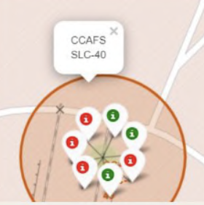
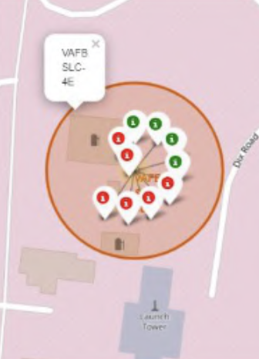
Markers showing launch sites with color labels
Green Markers show successful Launches and Red Markers shows failures
US MAP
Florida Launch Site
California Launch Site

Slide 41
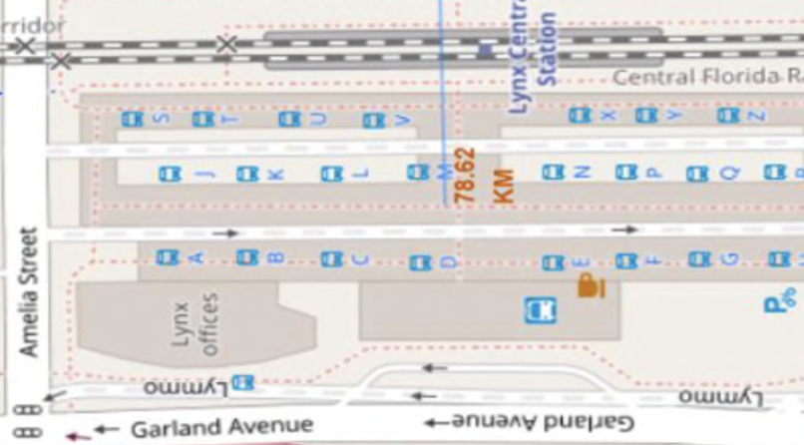
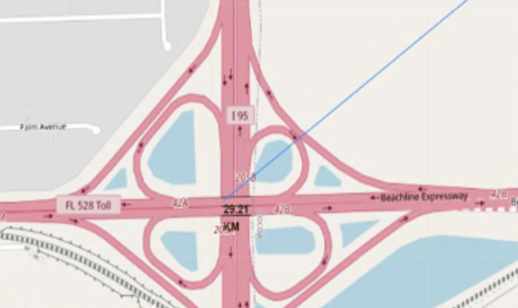
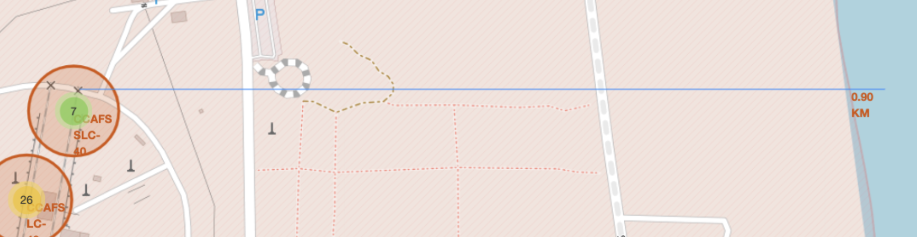
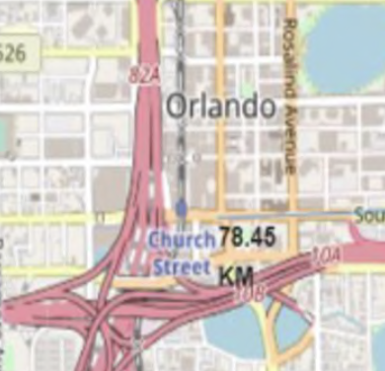
Launch Sites Distance to Landmarks
Launch sites are not near railways and highways
Launch sites are near coastlines
Launch sites keep certain distance from cities

Slide 42

Section 4

Slide 43
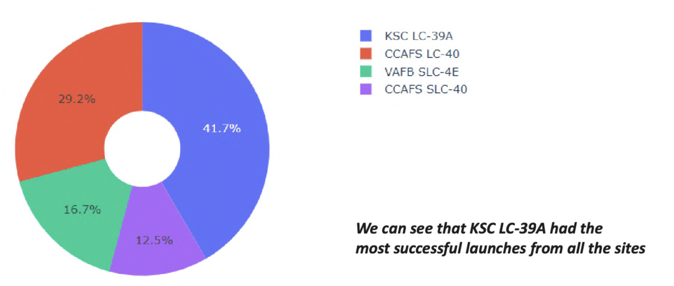
The success percentage by each sites.

Slide 44
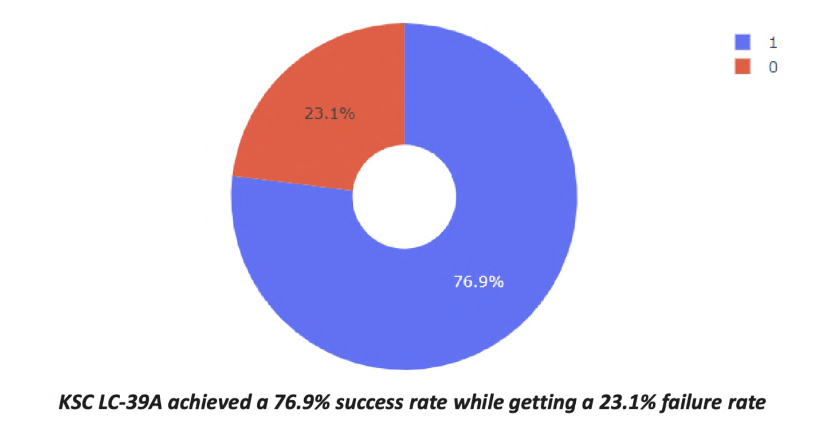
The highest launch-success ratio: KSC LC-39A

Slide 45
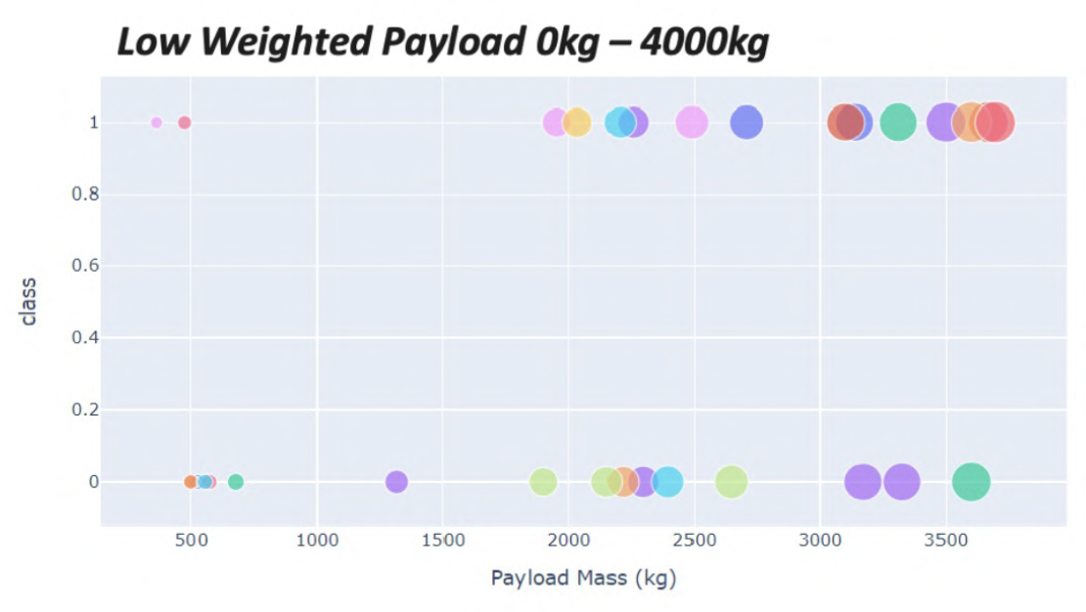
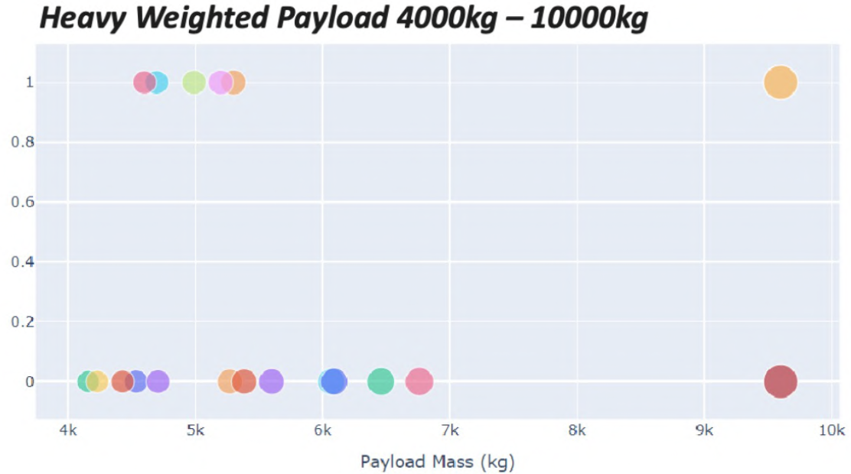
Payload vs Launch Outcome Scatter Plot
We can see that all the success rate for low weighted payload is higher than heavy weighted payload

Slide 46

Section 5

Slide 47

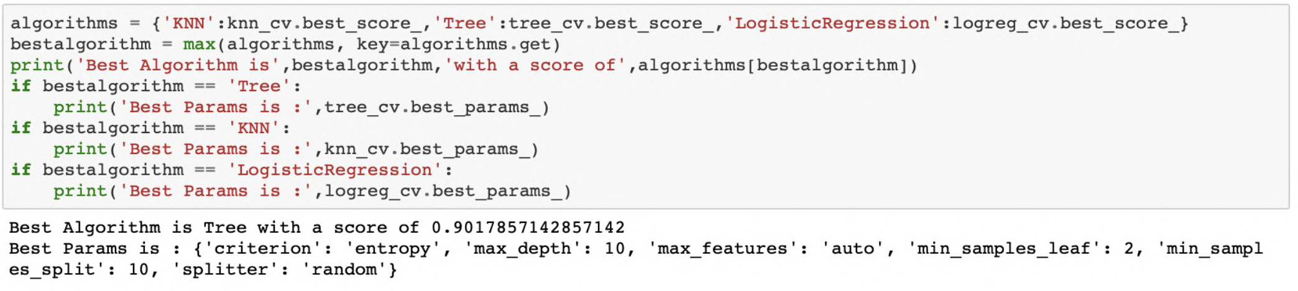
Classification Accuracy
As we can see, by using the code as below: we could identify that the best algorithm to be the Tree Algorithm which have the highest classification accuracy.

Slide 48
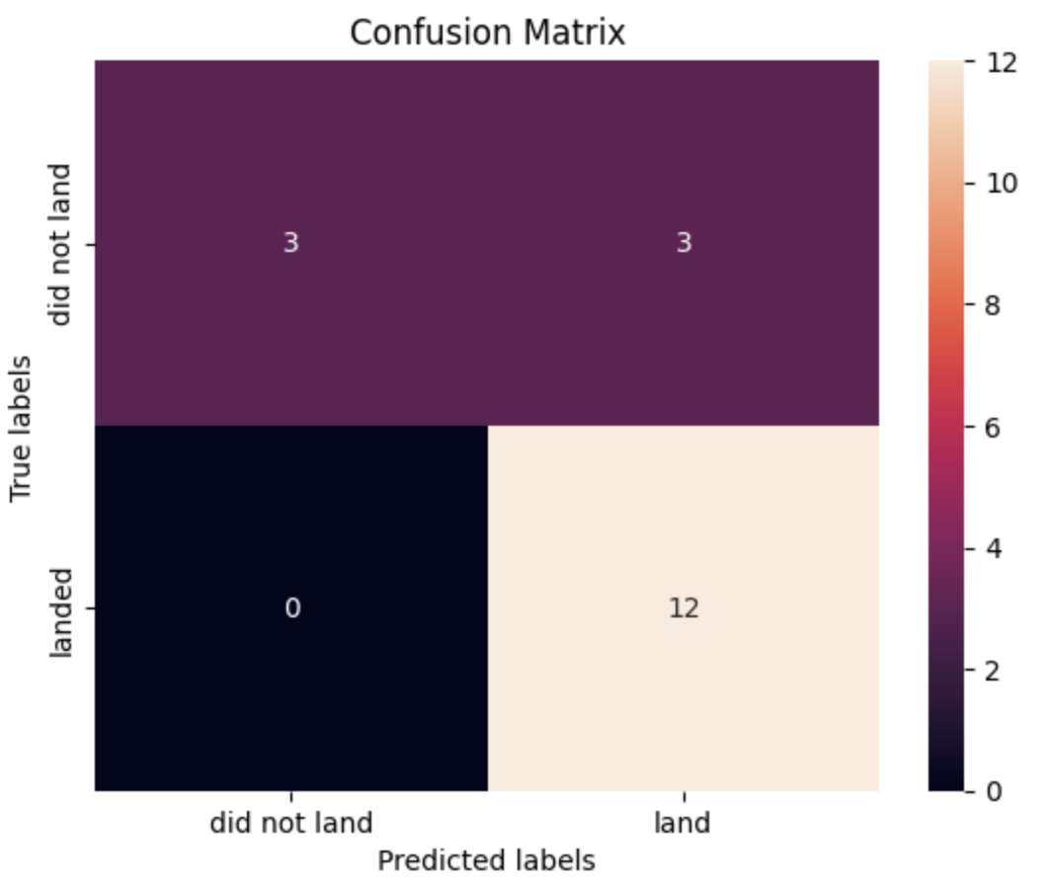
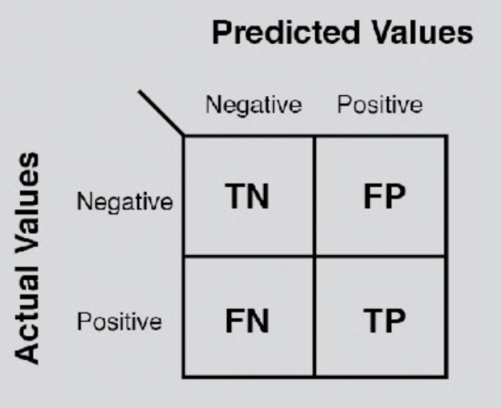
Confusion Matrix
The confusion matrix for the decision tree classifier shows that the classifier can distinguish between the different classes. The major problem is the false positives .i.e., unsuccessful landing marked as successful landing by the classifier.
Reference

Slide 49

Conclusions
The goal of model is to predict when Stage 1 will successfully land to save ~$100 million USD
The Tree Classifier Algorithm is the best Machine Learning approach for this dataset.
he low weighted payloads (which define as 4000kg and below) performed better than the heavy weighted payloads.
Starting from the year 2013, the success rate for SpaceX launches is increased, directly proportional time in years to 2020, which it will eventually perfect the launches in the future.
Created a dashboard for visualization years
SSO orbit have the most success rate; 100% and more than 1 occurrence.
Created a machine learning model with an accuracy of 83%

Slide 50
Appendix
Skills Labs
IBM Data Science Professional Certificate Course

Slide 51


